Slide 1
Layout (Continue)
Musadaq Mansoor
(Credits to Marty Stepp and Stanford Computer Science)

Slide 2
Grid Layout
lays out widgets/views in lines of rows and columns
orientation attribute defines row-major or column-major order
introduced in Android 4; replaces older TableLayout
by default, rows and columns are equal in size
each widget is placed into "next" available row/column index unless it is given an explicit layout_row and layout_column attribute

Slide 3
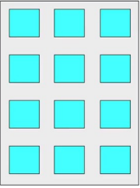
Grid of 4 rows, 3 columns

Slide 4
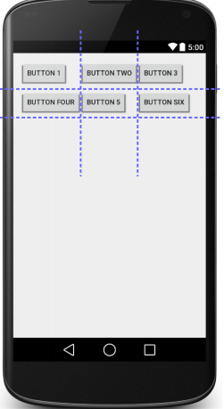
Example
<GridLayout ...
android:rowCount="2"
android:columnCount="3"
tools:context=".MainActivity">
<Button ... android:text="Button 1" />
<Button ... android:text="Button Two" />
<Button ... android:text="Button 3" />
<Button ... android:text="Button Four" />
<Button ... android:text="Button 5" />
<Button ... android:text="Button Six" />
</GridLayout>

Slide 5
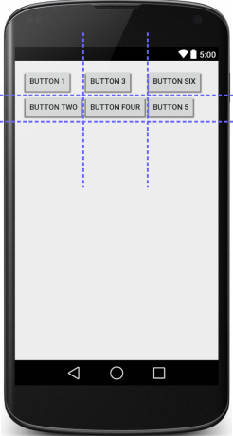
Example2
<GridLayout ...
android:rowCount="2"
android:columnCount="3"
android:orientation="vertical">
<Button ... android:text="Button 1" />
<Button ... android:text="Button Two" />
<Button ... android:text="Button 3" />
<Button ... android:text="Button Four" />
<Button ... android:text="Button 5"
android:layout_row="1"
android:layout_column="2" />
<Button ... android:text="Button Six"
android:layout_row="0"
android:layout_column="2" />
</GridLayout>

Slide 6
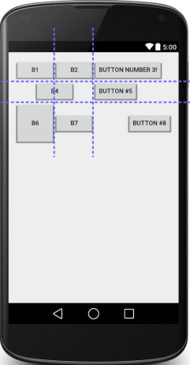
Example 3
<GridLayout ...
android:rowCount="2"
android:columnCount="3">
<Button ... android:text="B1" />
<Button ... android:text="B2" />
<Button ... android:text="Button Number 3!" />
<Button ... android:text="B4"
android:layout_columnSpan="2"
android:layout_gravity="center" />
<Button ... android:text="B5" />
<Button ... android:text="B6"
android:layout_paddingTop="40dp"
android:layout_paddingBottom="40dp" />
<Button ... android:text="B7" />
<Button ... android:text="Button #8"
android:layout_gravity="right" />
</ GridLayout >

Slide 7
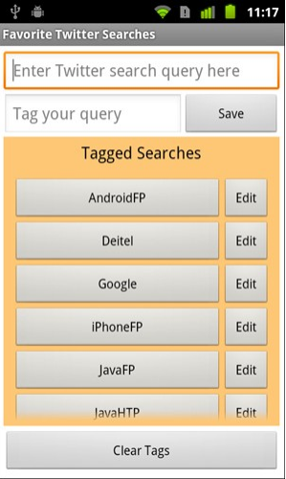
Nested Layout
<OuterLayoutType ...>
<InnerLayoutType ...>
<Widget ... />
<Widget ... />
</InnerLayoutType>
<InnerLayoutType ...>
<Widget ... />
<Widget ... />
</InnerLayoutType>
<Widget ... />
<Widget ... />
</OuterLayoutType>

Slide 8
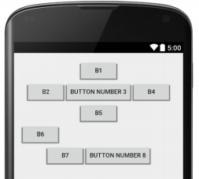
Nested Layout Exercise
Write the layout XML necessary to create the following app UI.
How many overall layouts are needed?
Which widgets go into which layouts?

Slide 9
Solution
<LinearLayout ...
android:orientation="vertical" android:gravity="center|top">
<Button ... android:text="B1" />
<LinearLayout ...
android:layout_width="match_parent"
android:layout_height="wrap_content"
android:orientation="horizontal"
android:gravity="center|top">
<Button ... android:text="B2" />
<Button ... android:text="Button Number 3" />
<Button ... android:text="B4" />
</LinearLayout>
<Button ... android:text="B5" />
<Button ... android:text="B6" android:layout_gravity="left" />
<LinearLayout ...
android:layout_width="match_parent"
android:layout_height="wrap_content"
android:orientation="horizontal"
android:gravity="center|top">
<Button ... android:text="B7" />
<Button ... android:text="Button Number 8" />
</LinearLayout>
</LinearLayout>

Slide 10
Relative Layout
each widget's position and size are relative to other views
relative to "parent" (the activity itself)
relative to other widgets/views
x-positions of reference: left, right, center
y-positions of reference: top, bottom, center
intended to reduce the need for nested layouts

Slide 11
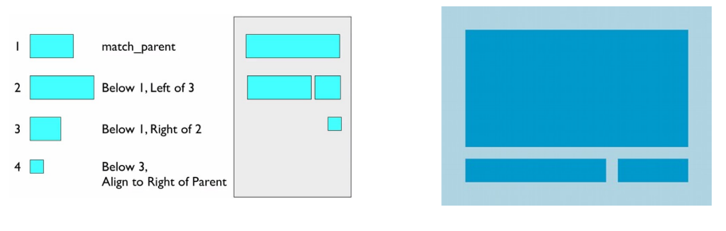

Slide 12
Relative Anchor Points
properties for x/y relative to another widget:
layout_below, above, toLeftOf, toRightOf
set these to the ID of another widget in the format "@id/theID"
(obviously, the given widget must have an ID for this to work)
properties for x/y relative to layout container (the activity):
layout_alignParentTop, Bottom, Left, Right
set these flags to a boolean value of "true" to enable them
layout_centerHorizontal, Vertical, InParent
set these flags to "true" to center the control within its parent in a dimension

Slide 13
Example
<RelativeLayout ... >
<Button ... android:id="@+id/b1" android:text="B1"
android:layout_alignParentTop="true"
android:layout_centerHorizontal="true" />
<Button ... android:id="@+id/b2" android:text="B2"
android:layout_alignParentLeft="true"
android:layout_below="@+id/b1" />
<Button ... android:id="@+id/b3" android:text="B3"
android:layout_centerHorizontal="true"
android:layout_below="@+id/b2" />
<Button ... android:id="@+id/b4" android:text="B4"
android:layout_alignParentRight="true"
android:layout_below="@+id/b2" />
<TextView ... android:id="@+id/tv1"
android:text="I'm a TextView!"
android:layout_centerInParent="true" />
<Button ... android:id="@+id/b5" android:text="B5"
android:padding="50dp"
android:layout_centerHorizontal="true"
android:layout_alignParentBottom="true"
android:layout_marginBottom="50dp" />
</RelativeLayout>

Slide 14
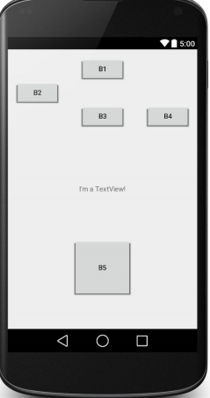
Solution

Slide 15
Frame Layout
meant to hold only a single widget inside,
which occupies the entirety of the activity
most commonly used with layout fragments (seen later)
less useful for more complex layouts
(can put in multiple items and move them to "front" in Z-order)

Slide 16

Example
<FrameLayout ... >
<ImageView
android:src="@drawable/jellybean"
... />
</FrameLayout>

Slide 17
Thanks
Any Questions?

